Slide 1
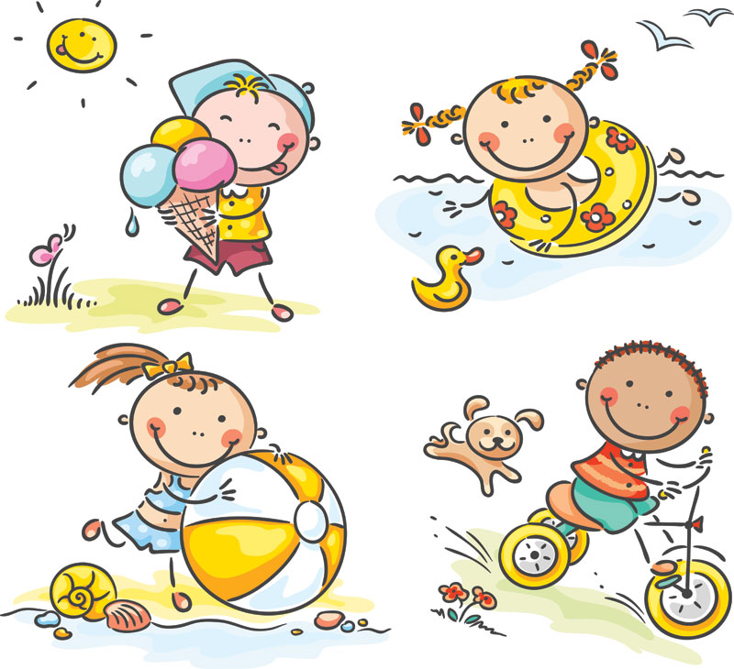
GRADE 4
UNIT TWO
My weekend
Lesson 6

Slide 2
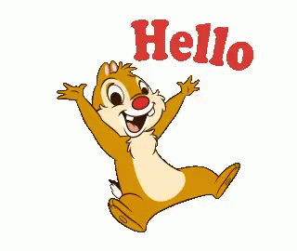

Slide 5
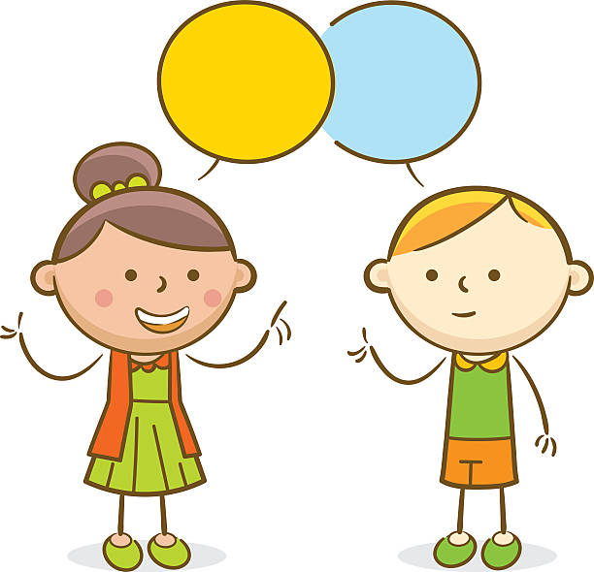
GAME TIME.
Yeah.

Slide 6
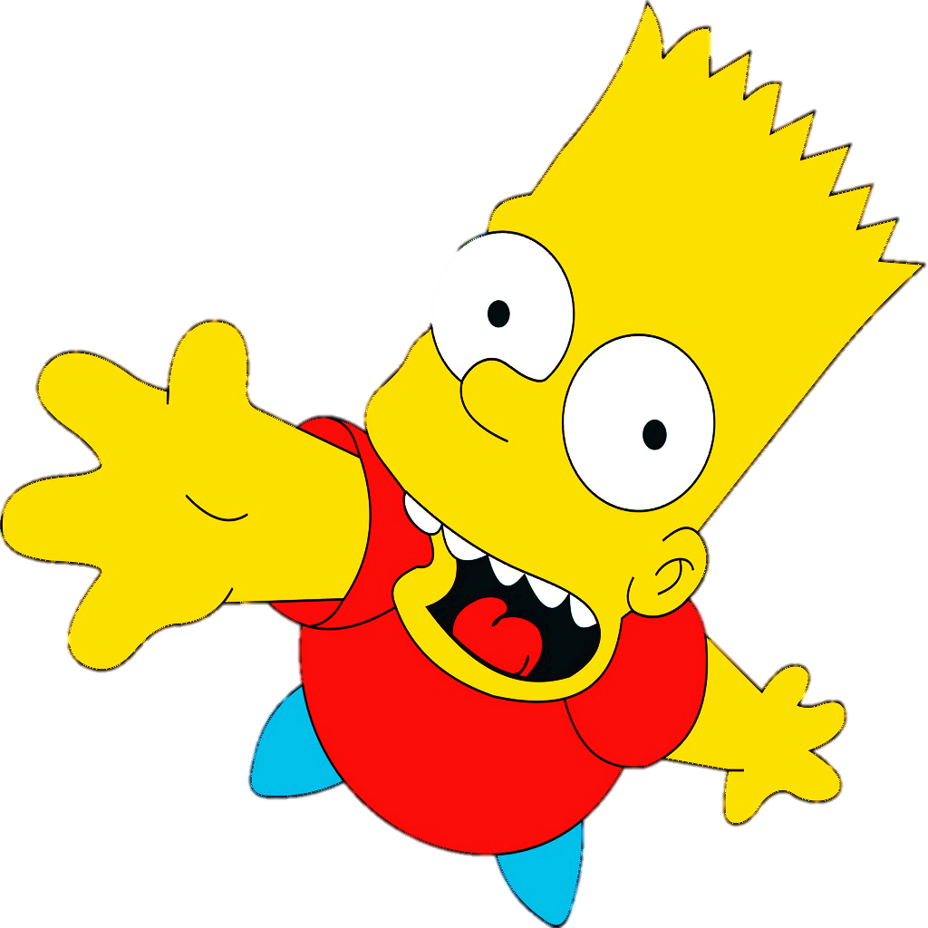
LIKE or DISLIKE

Slide 7
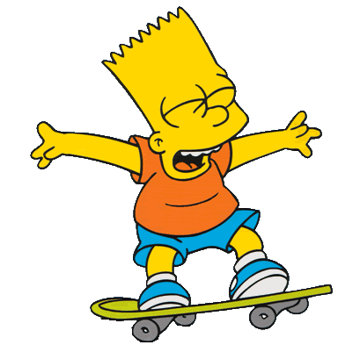
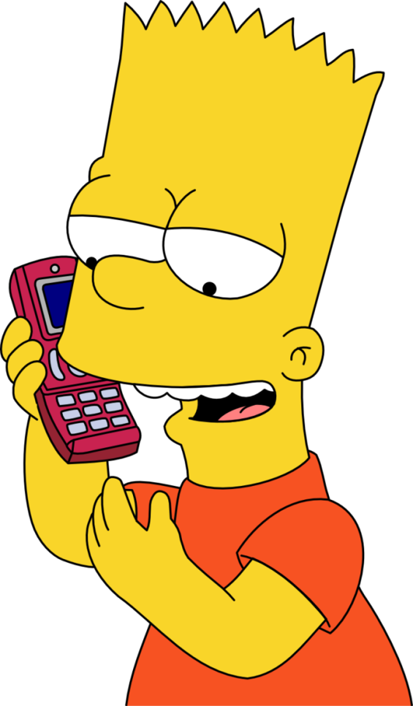
talking on the phone
Bart likes _______________________ .
He doesn’t like ________________________ .
CHECK
NEXT
skating

Slide 8
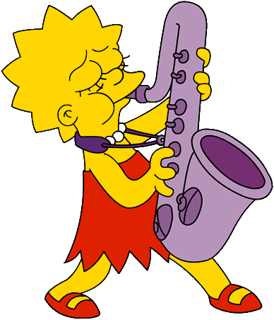
reading books
Lisa likes__________________.
She doesn’t like _________________________ .
CHECK
NEXT
playing the saxophone

Slide 9
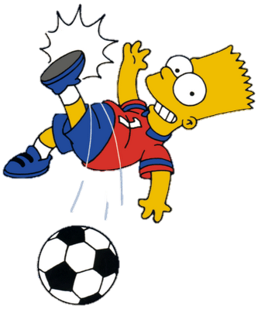
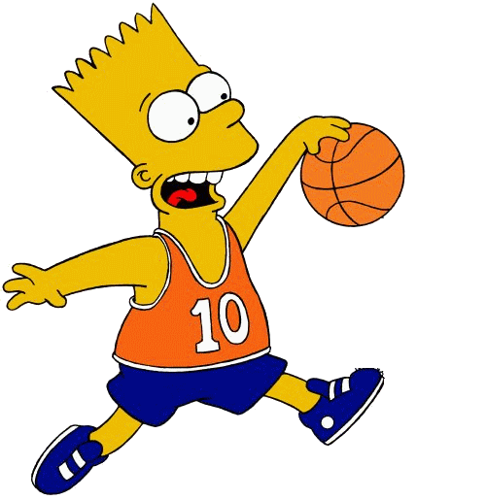
playing soccer
Bart likes ___________________.
He doesn’t like _______________________ .
CHECK
NEXT
playing basketball

Slide 10
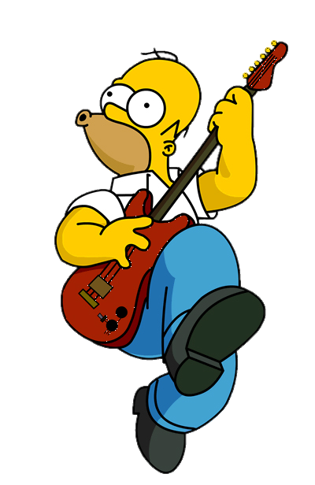
playing the guitar
Homer likes ____________________ .
He doesn’t like ______________________ .
CHECK
NEXT
using the computer

Slide 11
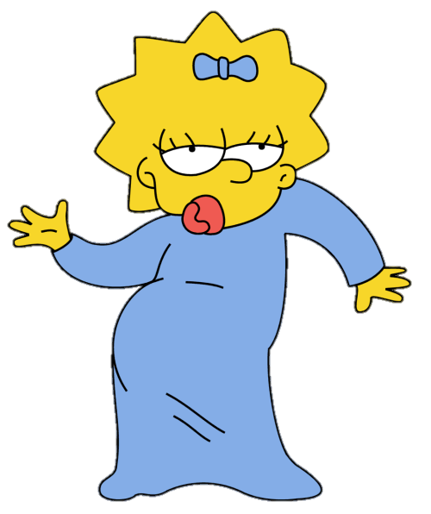
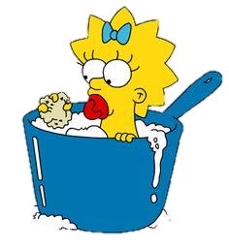
dancing
Maggie likes ________________ .
She doesn’t like ____________________ .
CHECK
NEXT
taking a bath

Slide 12
Task: Listen and match. What do they like?
2
3
4

Slide 13
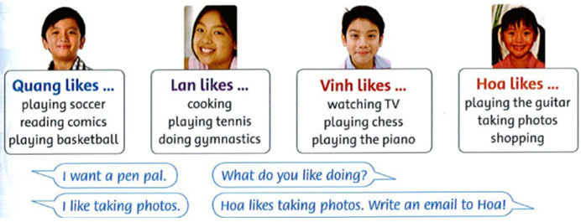
Pairwork: speaking ask and answer
Example:
What does Vinh like?

Slide 14
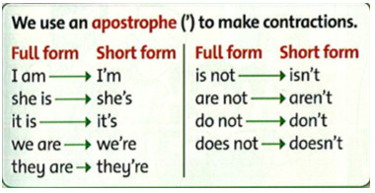
Task: writing Write about your classmates. Use apostrophes.
Examples:
He's eight.
She doesn't like ice cream.

Slide 15
Workbook time!!!

Slide 16
